Slide 1
ME 233 Advanced Control II Lecture 5 Random Vector Sequences
(ME233 Class Notes pp. PR6-PR10)
TexPoint fonts used in EMF.
Read the TexPoint manual before you delete this box.: AAAAAAAA

Slide 2
Outline
Random vector sequences
Mean, auto-covariance, cross-covariance
MIMO Linear Time Invariant Systems
State space systems driven by white noise
Lyapunov equation for covariance propagation

Slide 3
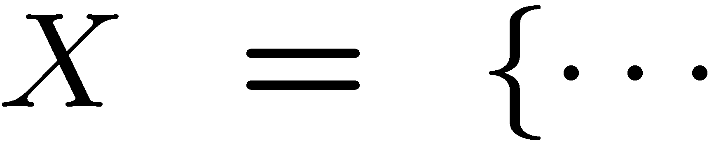
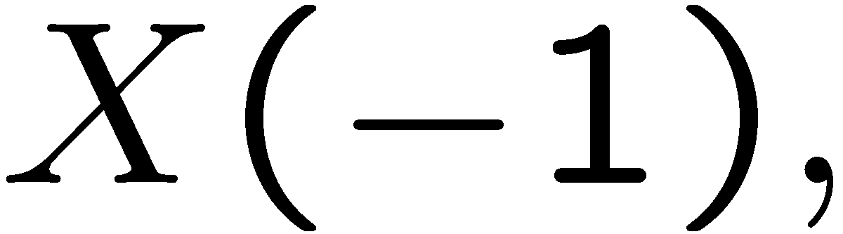
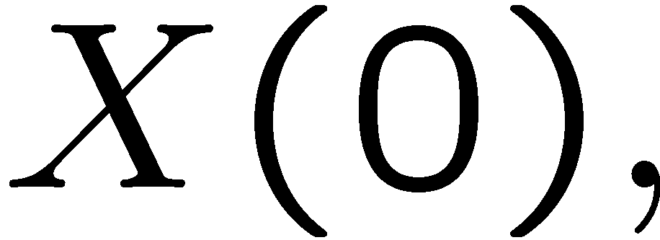
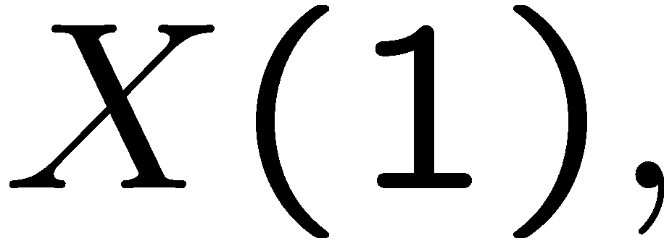
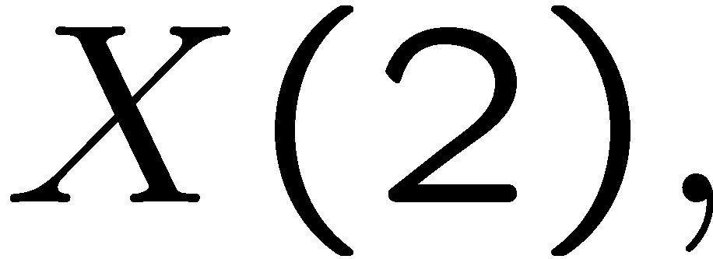
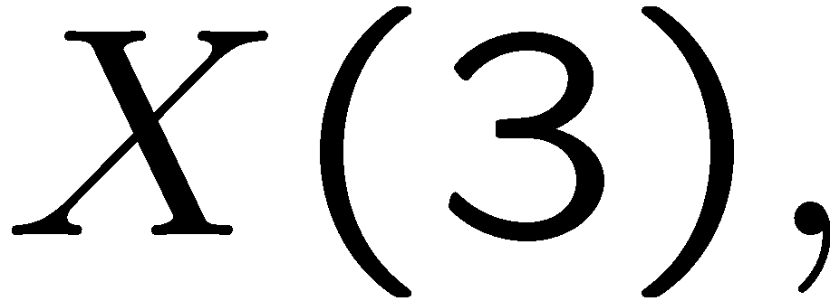
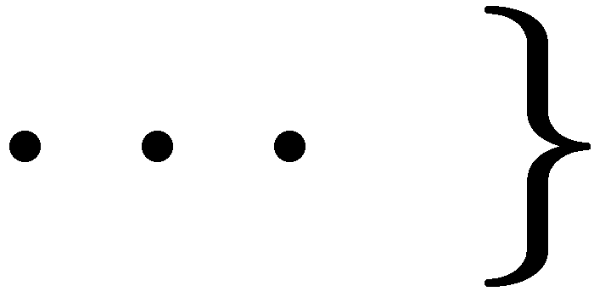
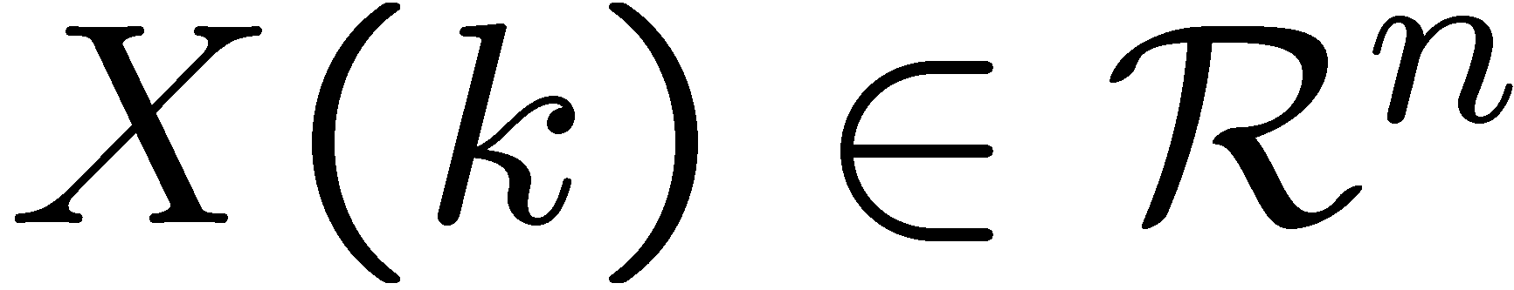
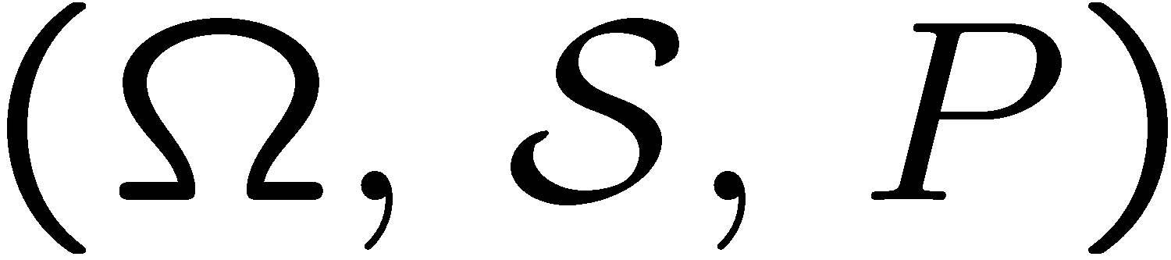
Random vector sequences
A two-sided random vector sequence is a collection of random vectors
each is itself a random vector
defined over the same probability space

Slide 4
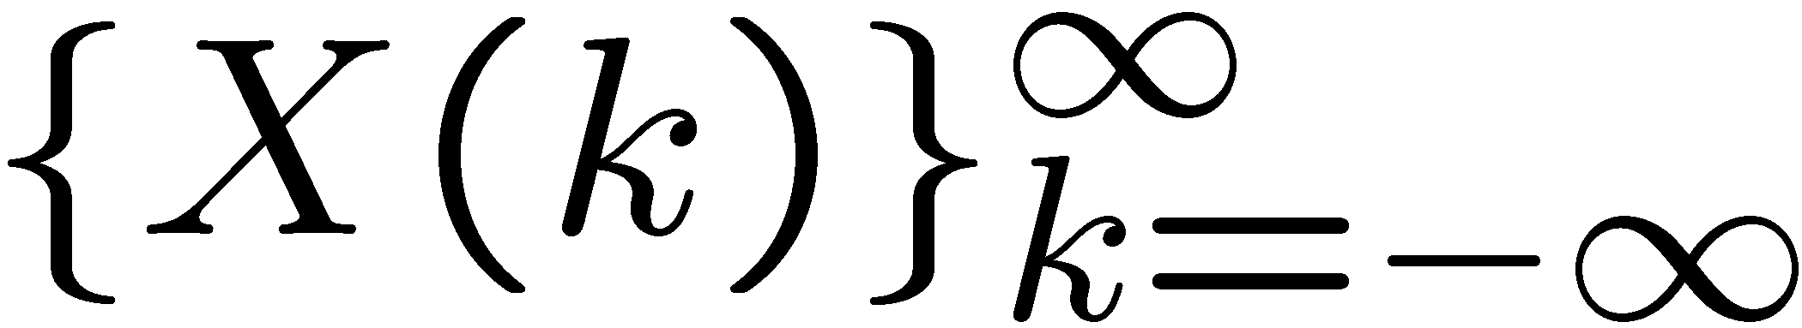
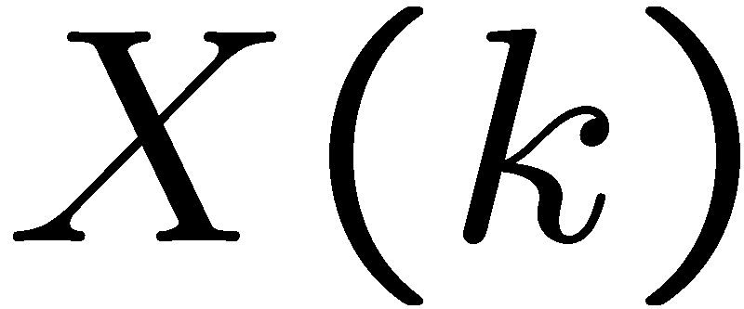
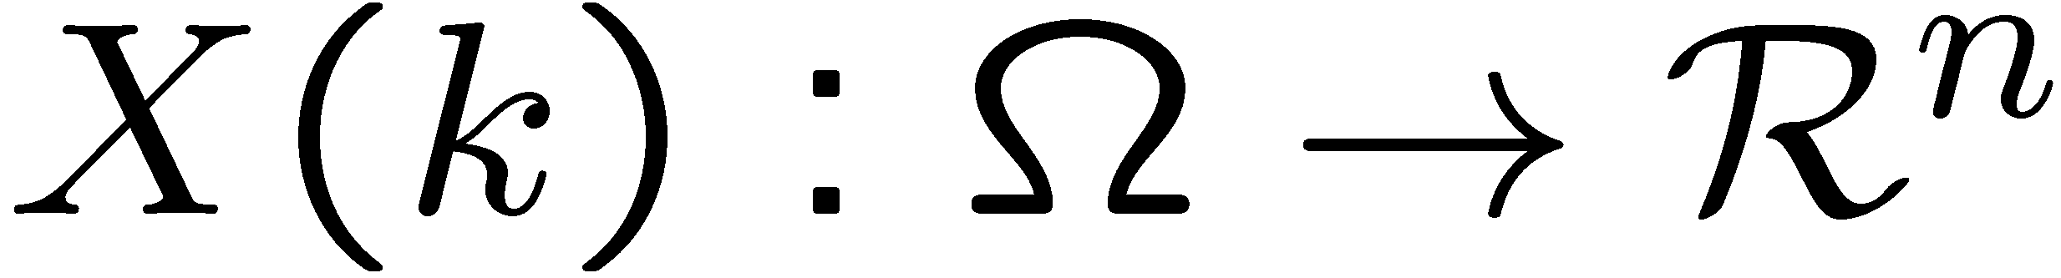
Random vector sequences
We either will use
or
Shorthand
(sloppy) notation
to denote the two-sided random vector sequence.
Each element of the sequence is a random vector:

Slide 5
Random vector sequences
A sample sequence
corresponds to the value of
obtained after performing an experiment

Slide 6
2nd order statistics
For a two-sided Random Vector Sequence (RVS)
Expected value or mean of X(k),

Slide 7
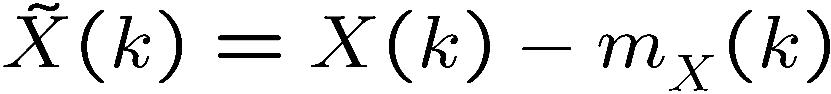
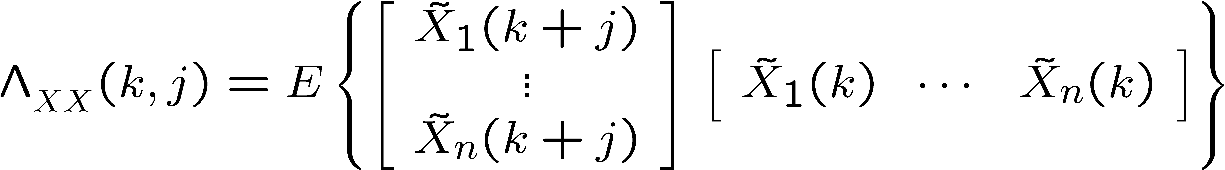
Auto-covariance
Define:

Slide 8
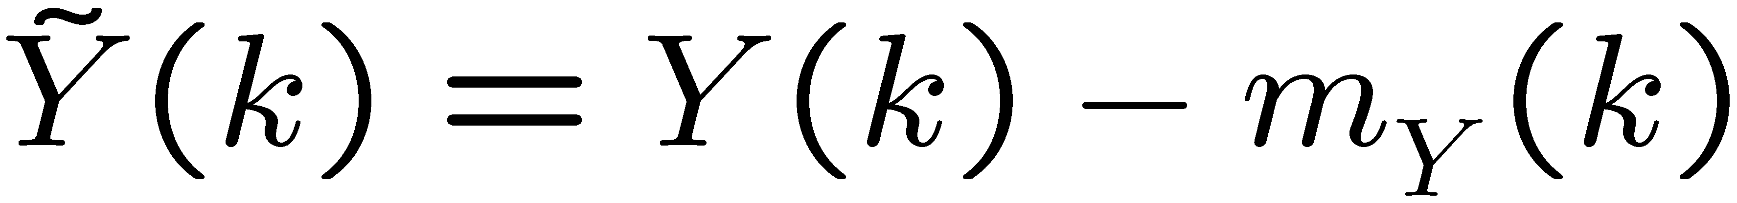
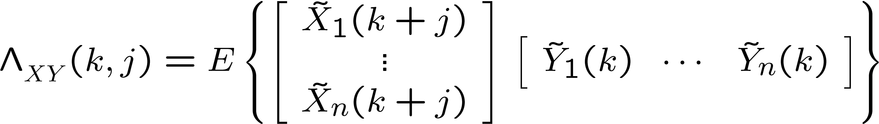
Cross-covariance
Define:

Slide 9
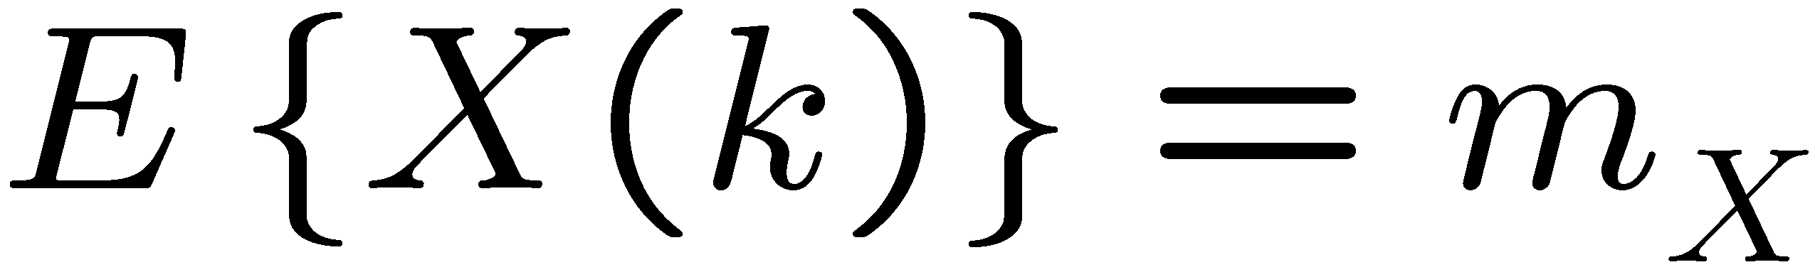
Wide Sense Stationary (WSS)
A two-sided random vector sequence
is WSS if:
(time invariant)
2)
(only depends on l)

Slide 10
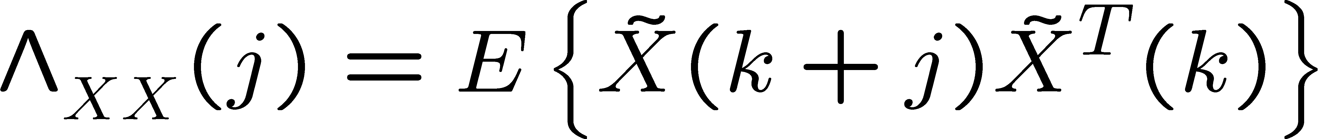
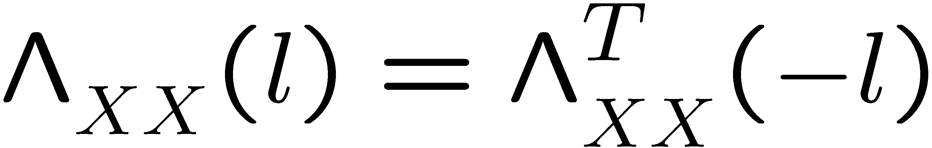
Auto-covariance function
For WSS RVS, the auto-covariance is only
a function of the correlation index j
for any index k

Slide 11
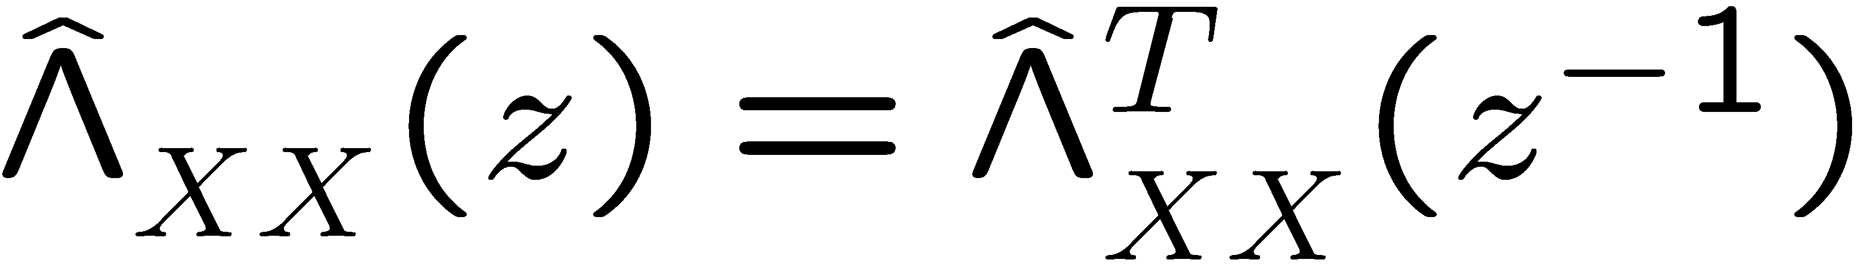
Auto-covariance function Z-transform
Z-transform

Slide 12
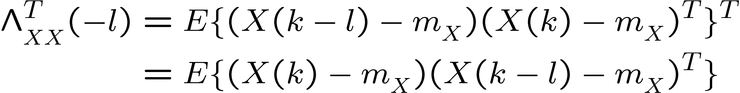
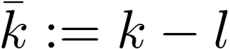
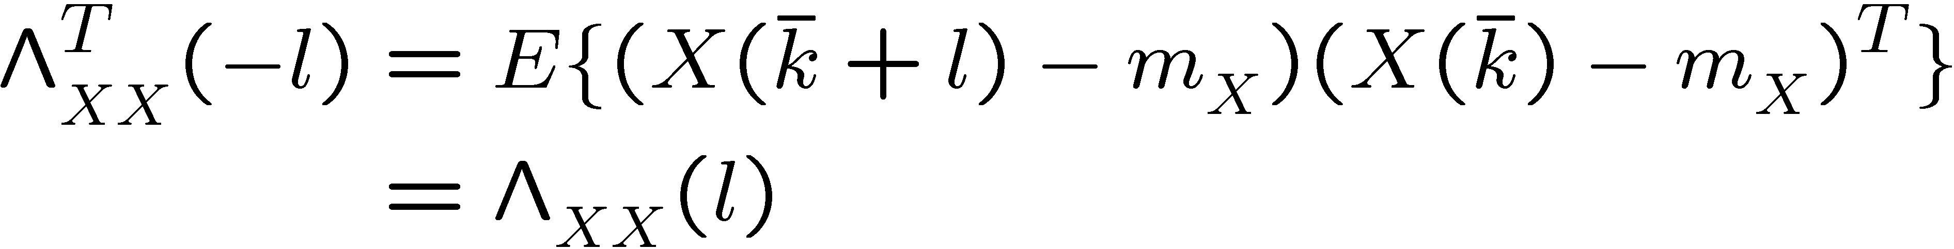
Auto-covariance function
Proof:
Define

Slide 13
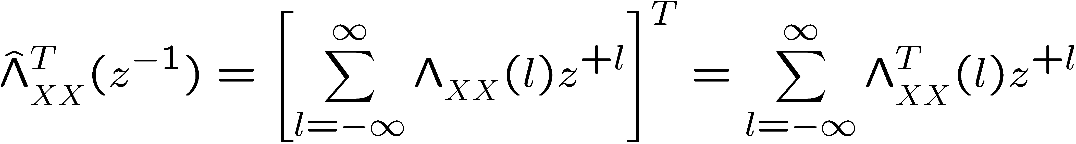
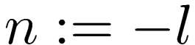
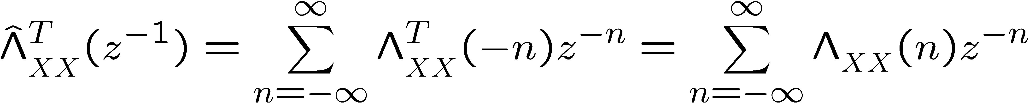
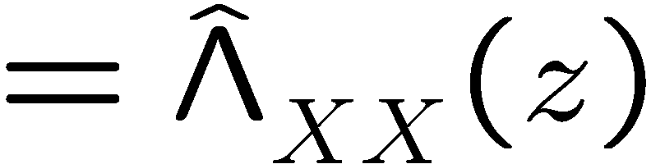
Auto-covariance function Z-transform
Proof:
Define

Slide 14
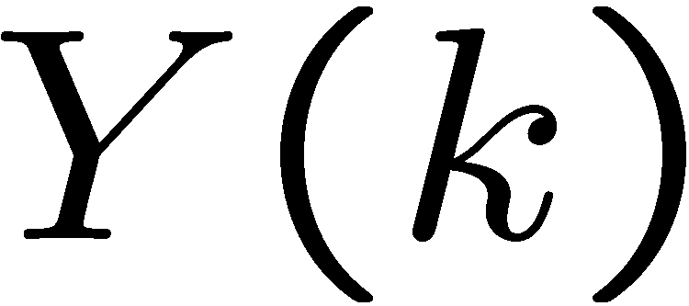
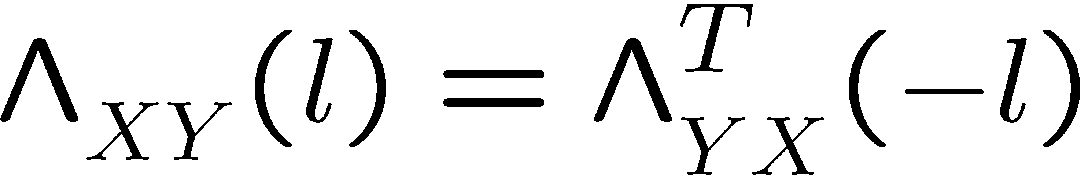
Cross-covariance function
and
are two WSS random vector sequences
for any index k
Notice that:

Slide 15
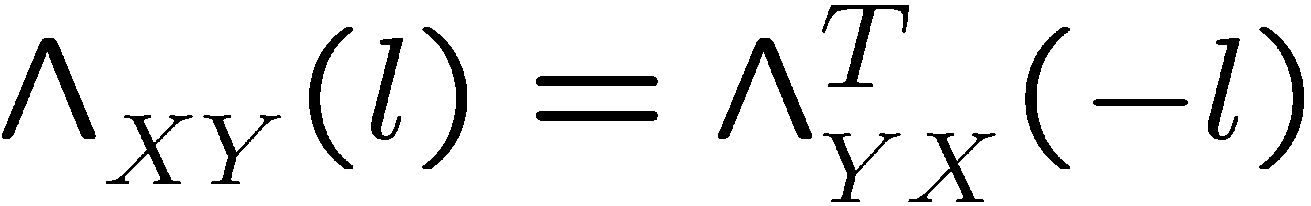
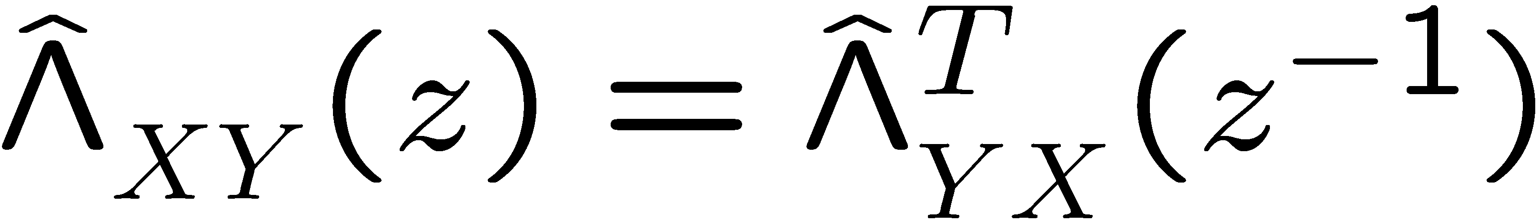
Auto-covariance function Z-transform
Z-transform

Slide 16
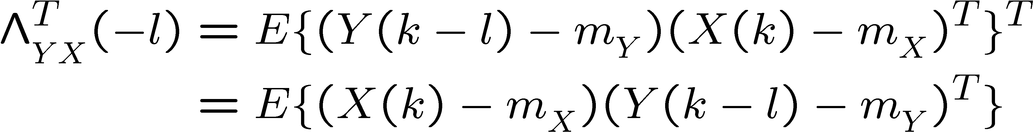
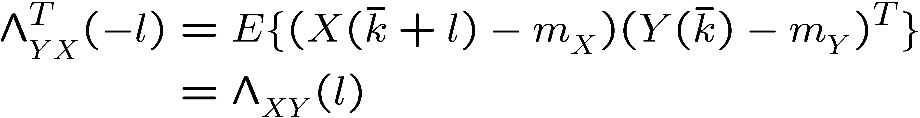
Cross-covariance function
Proof:
Define

Slide 17

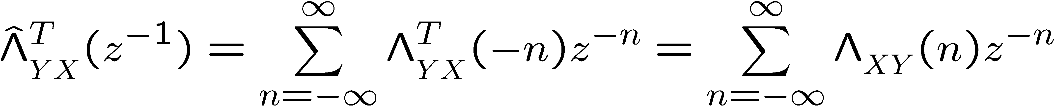
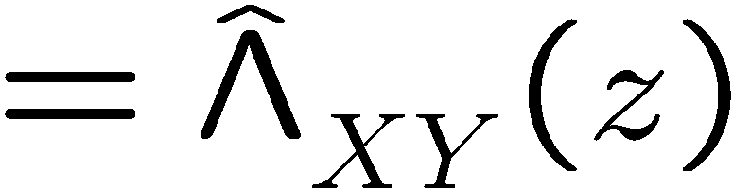
Auto-covariance function Z-transform
Proof:
Define

Slide 18
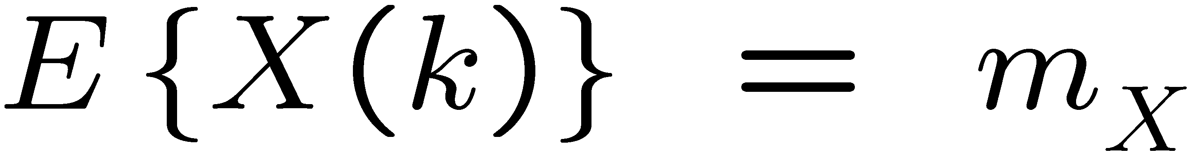
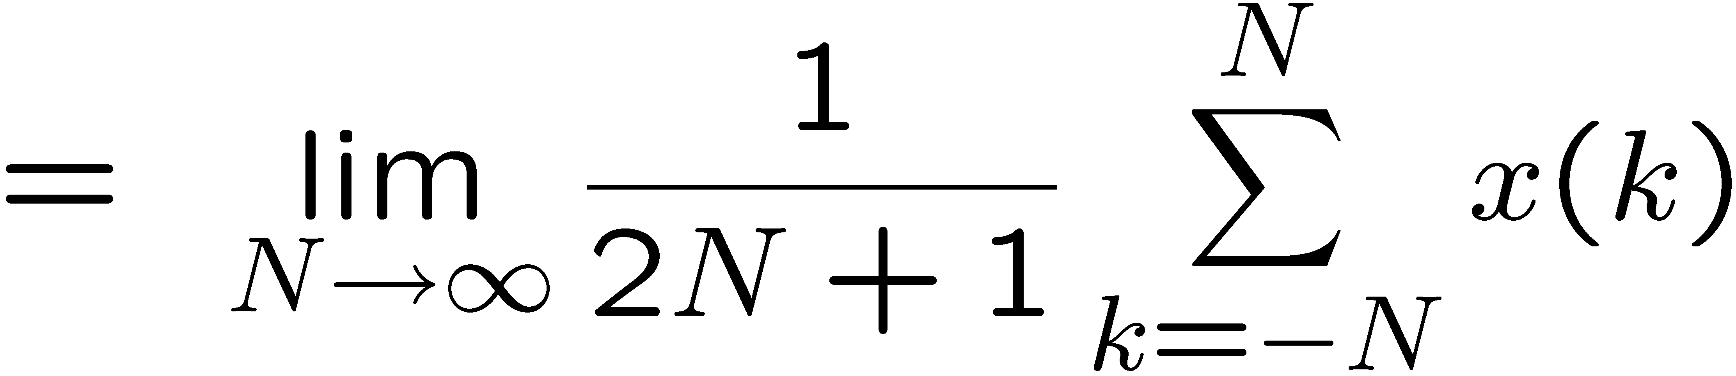
Ergodicity
A Wide Sense Stationary random sequence
is ergodic
if its ensemble average = time average (constant)
with probability 1
(almost surely)
sample sequence

Slide 19
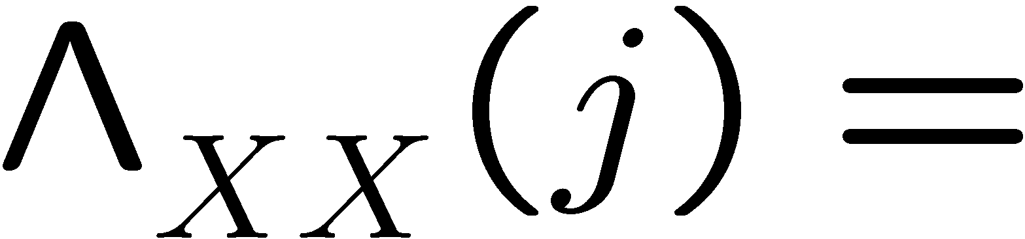
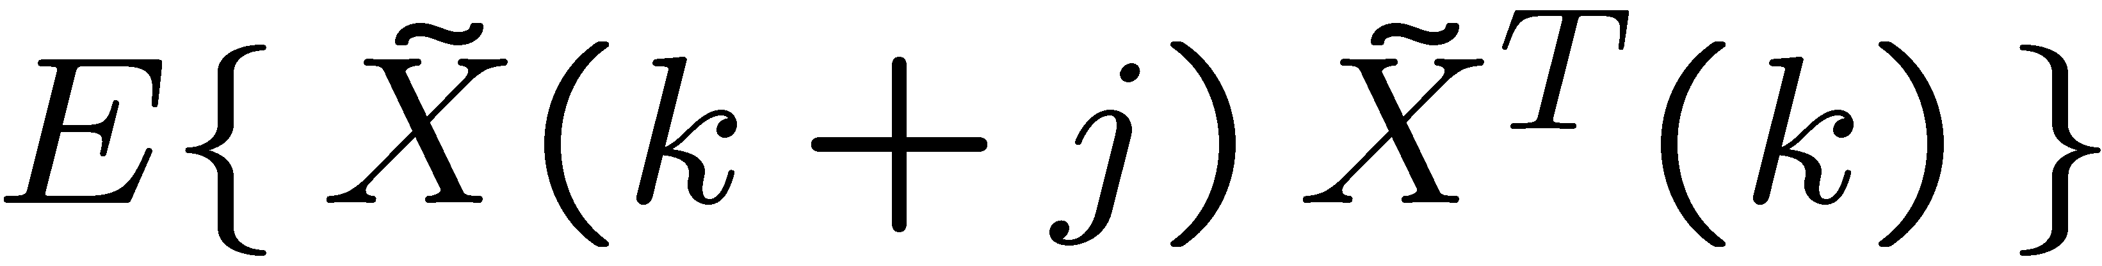
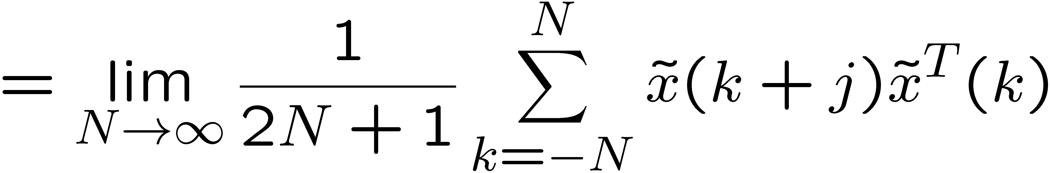
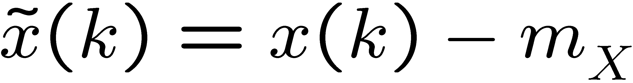
Ergodicity
For any WSS ergodic random sequence
we can approximate the covariance as a “time average”
with probability 1
(almost surely)
sample sequence

Slide 20
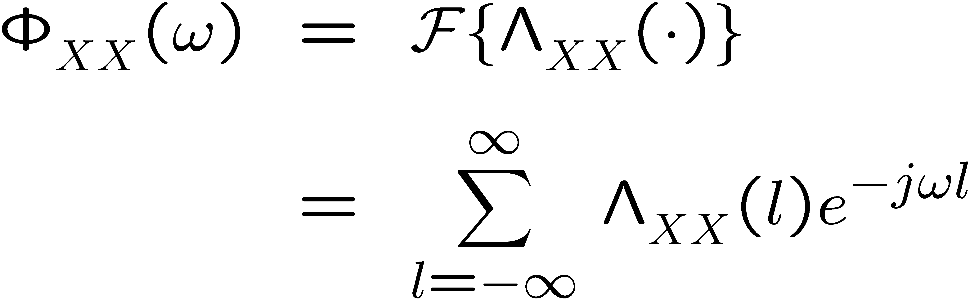
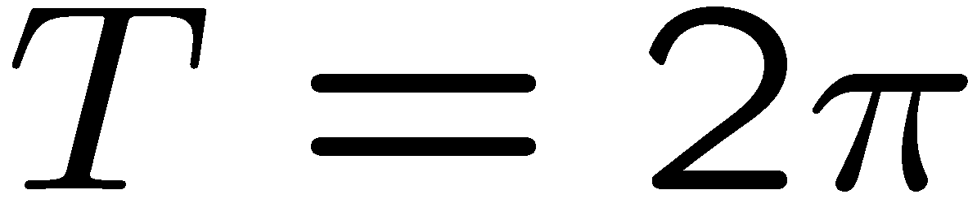
Power Spectral Density Function
Fourier transform of the auto-covariance function:
Complex-valued matrix
l: correlation index
Note:
The power spectral density function is periodic, with period

Slide 21
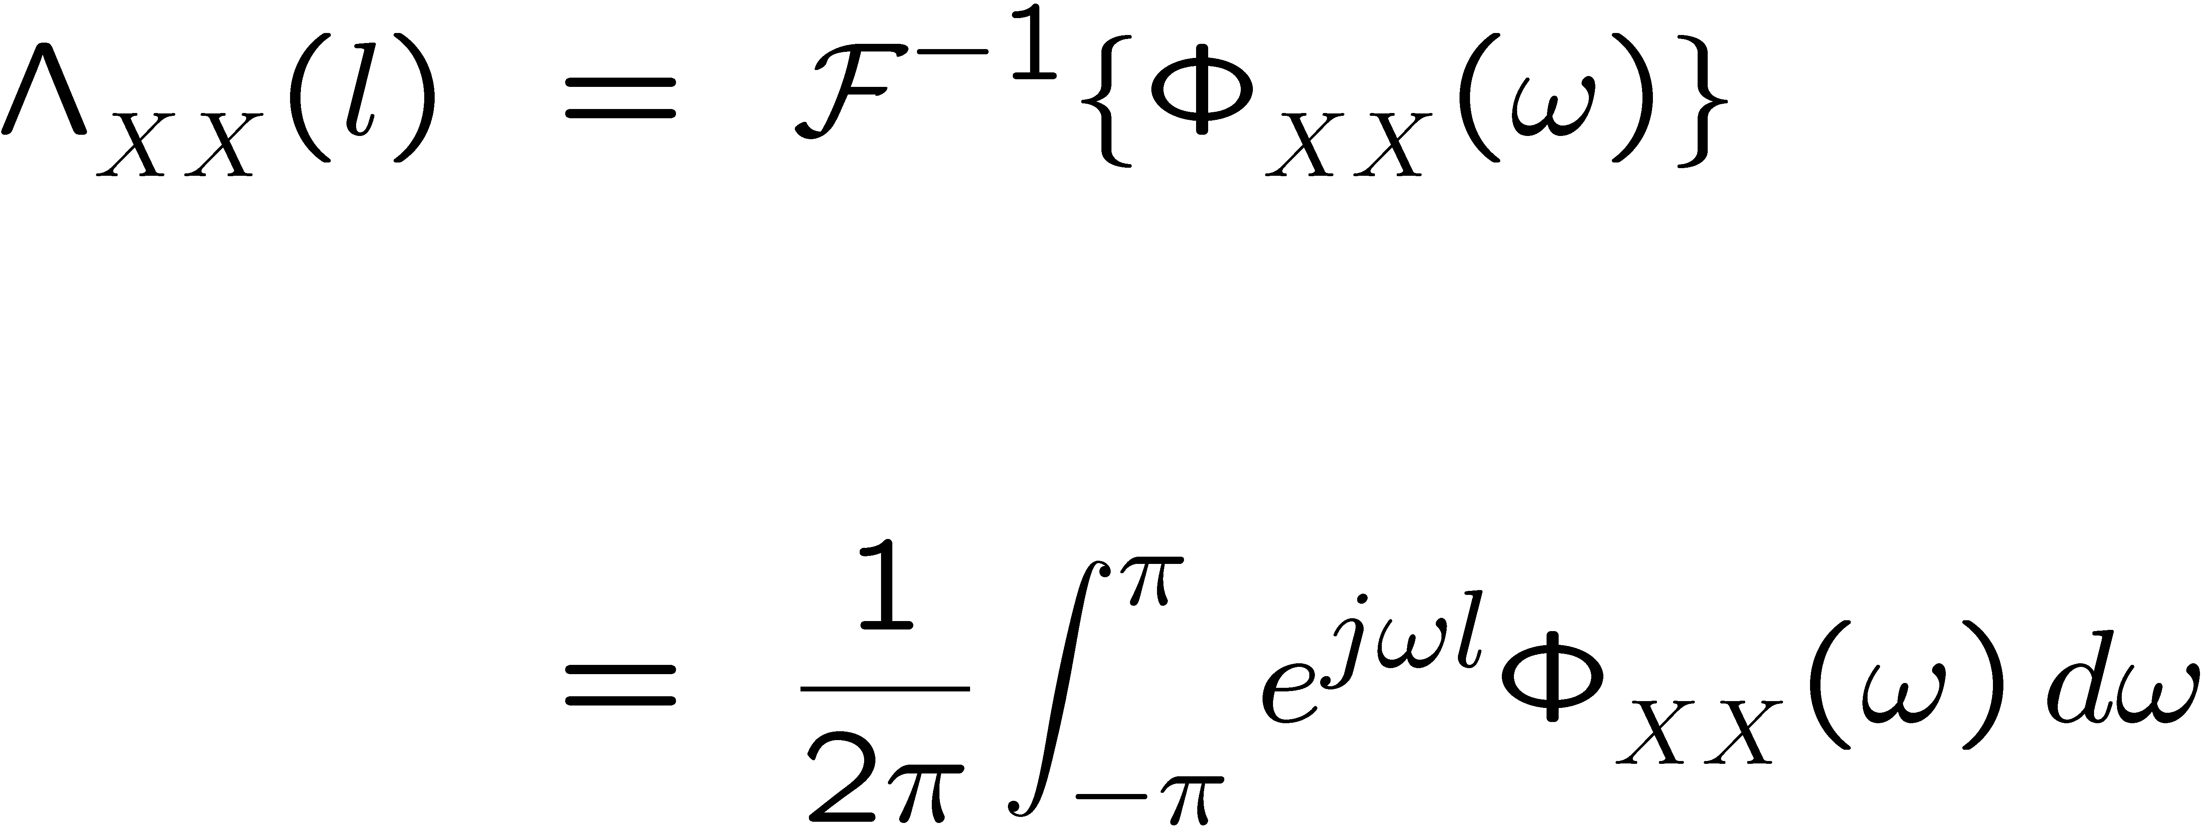
Power Spectral Density Function
Using the inverse Fourier transform we obtain:

Slide 22
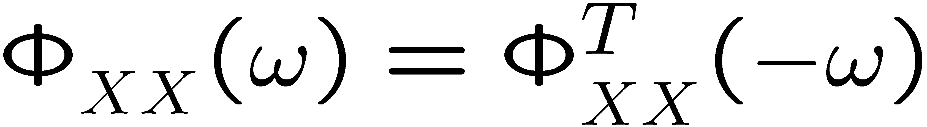
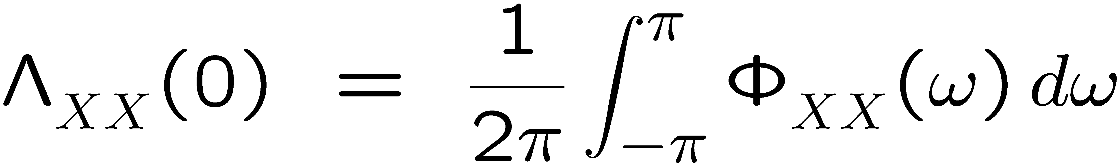
Power Spectral Density Function
Properties of the power spectral density function:

Slide 23
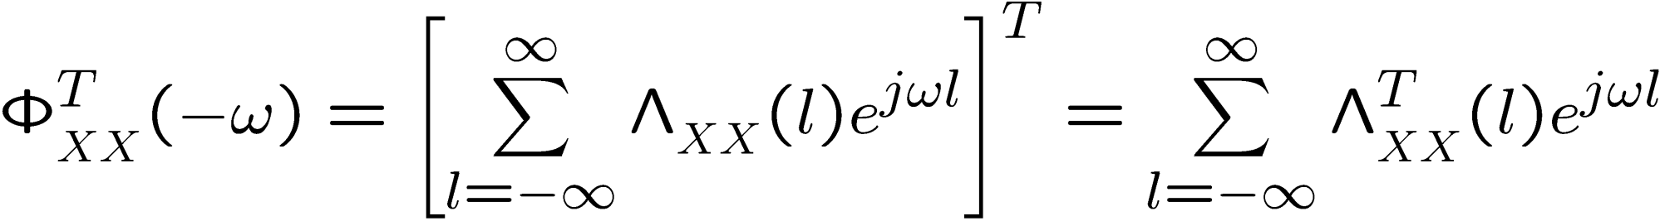
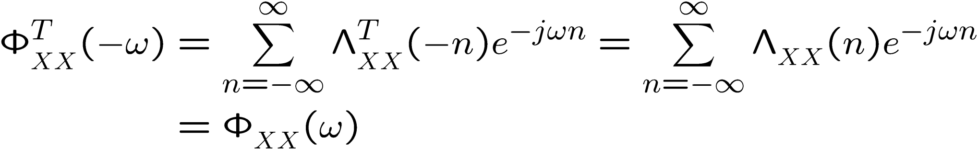
Power Spectral Density Function
1.
Proof:
Define

Slide 24
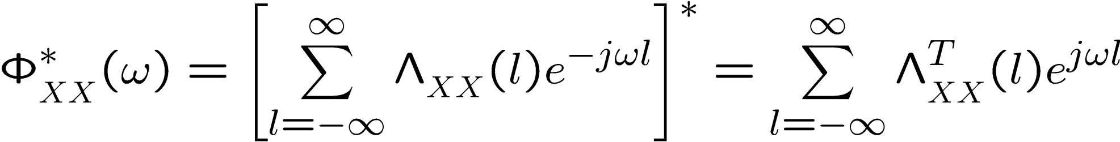
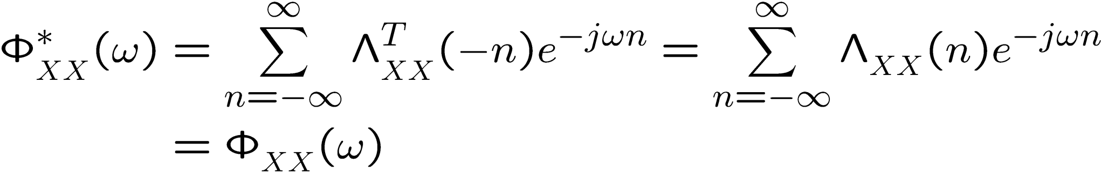
Power Spectral Density Function
2.
Proof:
Define

Slide 25

Power Spectral Density Function
Properties of the power spectral density function:
(scalar case)

Slide 26






White noise vector sequence
A WSS random vector sequence is white if:
where

Slide 27


White noise vector sequence
Given the white WSS random sequence
with
Its power spectral density (Fourier transform)
is

Slide 28


White noise illustration (scalar case)
zero-mean white noise
Matlab commands:
w = randn(N,1);
first 20 samples

Slide 29



MIMO Linear Time Invariant Systems
Let with
be the pulse response of an asymptotically stable MIMO LTI system
Transfer function

Slide 30



MIMO Linear Time Invariant Systems
Let be WSS
The forced response (zero initial state)
is also WSS

Slide 31

MIMO Linear Time Invariant Systems
Let be WSS

Slide 32



MIMO Linear Time Invariant Systems
We will assume
is zero mean, I.e.
Thus, the forced response output is also zero mean

Slide 33



MIMO Linear Time Invariant Systems
Let be WSS
If
Then:

Slide 34




MIMO Linear Time Invariant Systems
Proof:
Then:

Slide 35









MIMO Linear Time Invariant Systems
Let be WSS

Slide 36



MIMO Linear Time Invariant Systems
Let be WSS
If
Then:

Slide 37


MIMO Linear Time Invariant Systems
Proof:
Then:

Slide 38








MIMO Linear Time Invariant Systems
Let be WSS

Slide 39


MIMO Linear Time Invariant Systems
This is a consequence of the fact that

Slide 40




MIMO Linear Time Invariant Systems
Proof:
Define

Slide 41
MIMO Linear Time Invariant Systems
If
Then:

Slide 42

MIMO Linear Time Invariant Systems
Proof:

Slide 43
MIMO Linear Time Invariant Systems
If
Then:

Slide 44



MIMO Linear Time Invariant Systems
Proof:
Let z = e^{jω}

Slide 45
Next Topic
Stable causal LTI systems driven by uncorrelated random vector sequences
State-space
No WSS assumption
Similar to “white”
Definition in 2 slides

Slide 46



2nd order statistics of a random sequence
We now consider one-sided random sequence
Expected value or mean of X(k),
Auto-covariance function:

Slide 47


Uncorrelated random vector sequence
A random vector sequence is uncorrelated if:
where

Slide 48
Subtracting the mean
Define
Auto-covariance

Slide 49




State space systems
Consider a LTI system driven by an uncorrelated RVS:

Slide 50

State space systems
W(k) is an uncorrelated RVS

Slide 51




State space systems
State Initial Conditions (IC):

Slide 52

Dynamics of the mean
Taking expectations on the equations above:

Slide 53



State space systems
Subtracting the means we obtain,
Where now

Slide 54




Causality in cross-covariance
Proof: (by induction on k)
Base case, k=0 : trivial by assumptions on system
Case k>0 :
0
(by induction hypothesis)

Slide 55

Covariance propagation
Notice that:

Slide 56


Covariance propagation
Taking expectations to:

Slide 57


Covariance propagation
Notice that:
0
0
(W(k) is an uncorrelated RVS)

Slide 58

Covariance propagation
We obtain the following Lyapunov equation:

Slide 59

Covariance propagation
From the output equation
we obtain

Slide 60


Covariance propagation
Lets now compute,
Using the solution of the LTI system,

Slide 61



Covariance propagation
0

Slide 62




Covariance propagation
Lets now compute
define

Slide 63

Covariance propagation
Satisfies:

Slide 64





Stationary covariance equation
If W(k) is WSS
and A is Schur (i.e. all eigenvalues inside unit circle):
and X(k) and Y(k) will converge to WSS RVS:

Slide 65

WSS Stationary covariance equation
For W(k) WSS,
and A Schur,
converges to

Slide 66

WSS Stationary covariance equation
For W(k) WSS,
and A Schur,
Satisfies the Lyapunov equation:

Slide 67



WSS Stationary covariance equation
For W(k) WSS,
and A Schur,
Satisfies

Slide 68




Illustration – first order system
Plant:
Input:
State initial conditions:

Slide 69
Matlab simulation: 500 sample sequences
lyy0 = 0.1
lww = 0.2
sys1=ss(.5,1,1,0,1)
N=20;
p=500;
w = sqrt(lww)*randn(N,p)+1;
y = zeros(N,p);
y0 = sqrt(lyy0)*randn(1,p);
k = (0:1:N-1)';
for j=1:p
[y(:,j),k] = lsim(sys1,w(:,j),k,y0(1,j));
end
m_y=mean(y')
L_yy=diag(cov(y'));

Slide 70
W(k)
(4 out of 500)
Ensemble
k

Slide 71
Y(k)
(4 out of 500)
Ensemble
k

Slide 72

Mean Transient Response
Actual:
Matlab calculation:
Ensemble mean
m_y=mean(y');
Not using ergodicity
because not WSS!!

Slide 73
Mean Transient Response
Calculated by
m_y=mean(y');

Slide 74



Covariance Transient Response
Actual:
Matlab calculation:
Ensemble covariance
L_yy=diag(cov(y'));
Not using ergodicity
because not WSS!!

Slide 75
Covariance Transient Response
Calculated by
L_yy=diag(cov(y'));

Slide 76


Steady State Covariance
Calculated by
L_yy=diag(cov(y'));

